Slide 1
TECHTRONIX

Slide 2
TABLE OF CONTENT
INTRODUCTION
FOCUS (ANALYSIS GOALS)
PROJECT DELIVERABLES
CONCLUSION

Slide 3
INTRODUCTION
Techtronix Innovations, a forefront player in the microchip and robotics industry, is encountering challenges in streaming its sales strategies, optimizing production planning and pursuing market expansion. The company boasts an extensive portfolio that caters to automotive, consumer electronics, and industrial sectors. However, it grapples with demand unpredictability, inventory management inefficiencies, and the identification of profitable market opportunities.
Over the previous year, Techtronix Innovations has meticulously compiled a dataset encompassing each transactions, encompassing sales data, customer interactions, product specifics, and financial metrics. This dataset presents an invaluable opportunity for in-depth business performance analysis, trend identification, and insight extraction to inform strategic decisions.

Slide 4
FOCUS (ANALYSIS GOALS)
You will utilize the dataset to guide Techtronix Innovations in overcoming its current obstacles through the creation of an automated Power BI report. This report should focus on:
Sales Performance Analysis: Uncover sales trends across various product categories, sectors, regions, and timeframes. Highlight the best and worst performers.

Slide 5
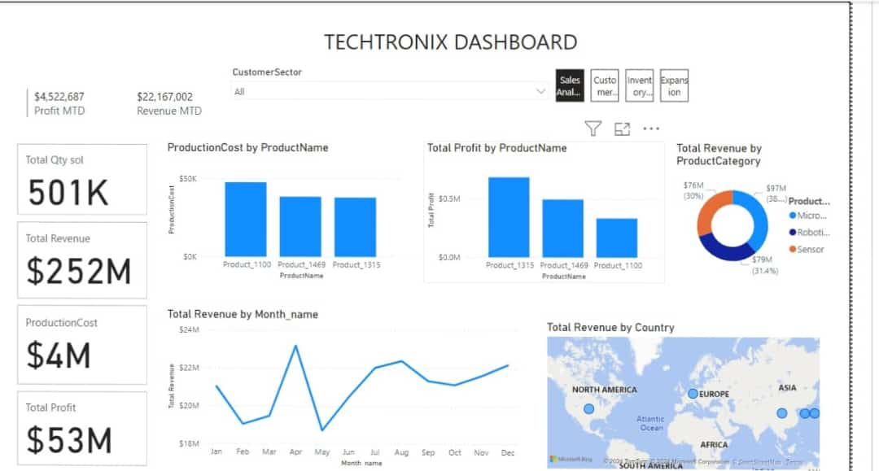
SALES PERFORMANCE ANALYSIS
From the sales Analysis, the product with the higher production cost tends to give lower profit. i.e. Product 1100 has the highest ProductionCost in comparison to product 1315, but has a low profit in comparison to product 1315, due to the high ProductionCost as expected. Also, noticeable was a high peak in the month of April in terms of total Revenue generated.

Slide 6
Customer Insights: Dive into customer segmentation to reveal purchase patterns, preferences by sector, and geographic distribution. Identify the sectors contributing most significantly to sales and profitability.

Slide 7
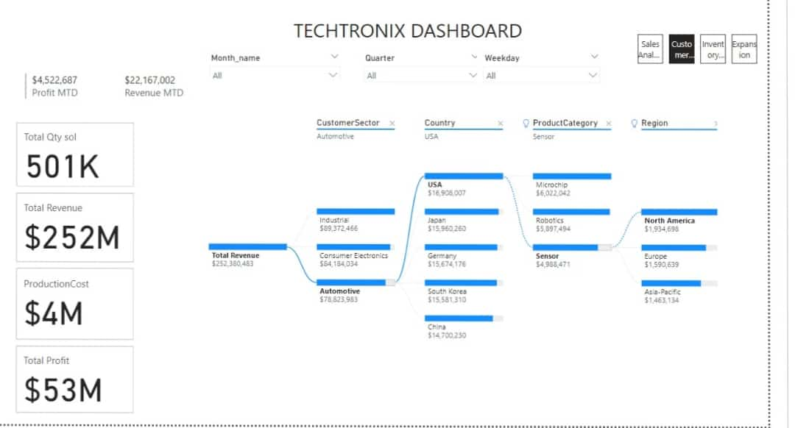
CUSTOMER INSIGHTS
From the graph, it is indicated that North America (USA) tend to purchase sensors used in automotive which generates more revenue than other ProductCategory.

Slide 8
Inventory Optimization: Evaluate inventory management against sales figures to pinpoint production planning mismatches, propose methods to better align production with market demands.

Slide 9
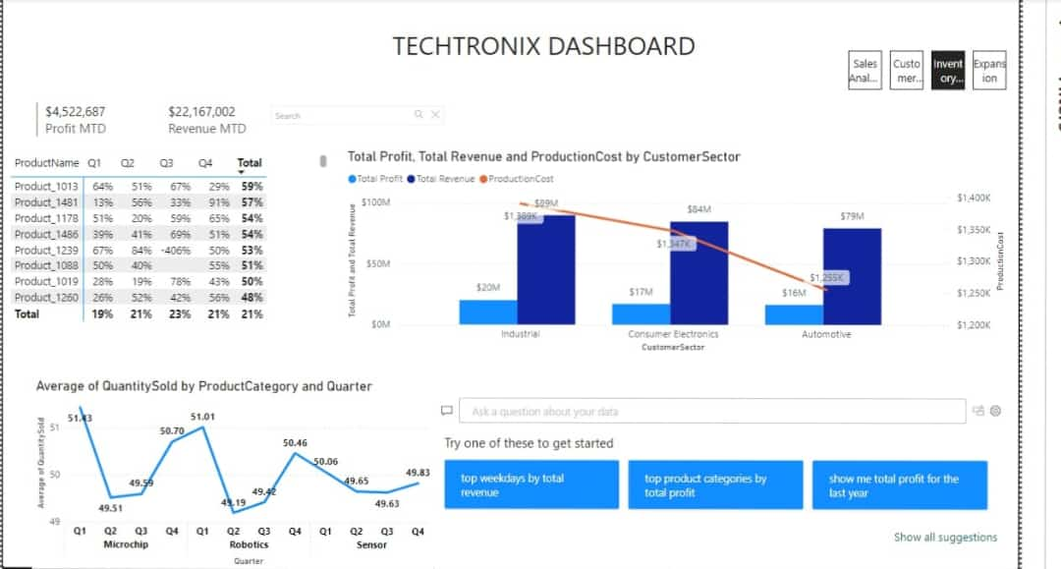
INVENTORY OPTIMIZATION
From the graph, Sensor products shows a good market value over time. It also shows a steady market demand.

Slide 10
Profitability Analysis: Analyze the profitability across different product categories, taking into account sales revenue and production costs. Point out products with high margins and suggest cost reduction strategies.

Slide 11
Market Expansion Opportunities: Analyze sales and customer data to discover new markets for expansion, emphasizing regions and sectors.

Slide 12
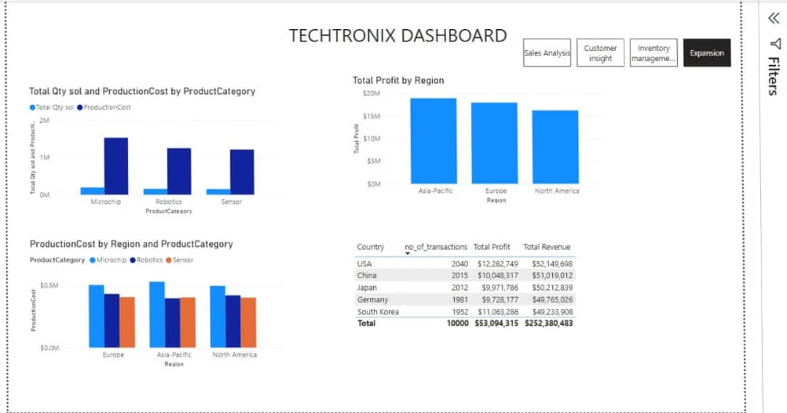
MARKET EXPANSION OPPORTUNITIES
From the graph, it is indicated that North America have a low production cost for sensor products in relation to the other product category. Thus, the USA experiences higher profit and revenue from sensor product.

Slide 13
CONCLUSION
It is indicated that North America(USA) tend to purchase sensors used in automotive which generates more revenue than other ProductCategory.
It also shows that North America have a low production cost for sensor products in relation to the other product category. Thus, the USA experiences higher profit and revenue from sensor products.
More emphasis should be made on sensor products as they tend to have more market demands, which leads to a higher Sales/Revenue.
Negotiate better prices for sensor production materials with existing suppliers that offer similar quality materials at lower costs. Bulk purchasing and long-term contracts could provide discounts.

